Slide 1

Introduction to Raspberry pi Programming.
Eng. NIYITEGEKA JANVIER
jniyitegeka@iprctuba..rp.ac.rw
IPRC TUMBA

Slide 2
What is a raspberry pi?

Slide 3
Cont’d
It is actually a small computer on board and It has the full functionality as other computers but limited capabilities,
it runs Linux as operating system and has a full network system.

Slide 4
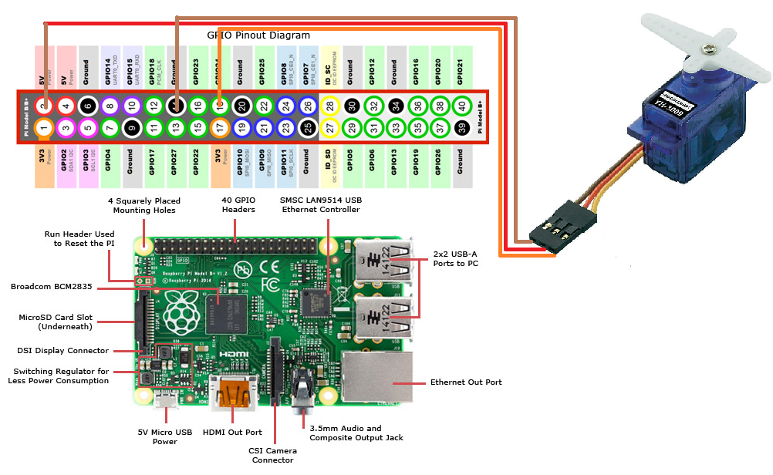
Raspberry Pi 2 Model B Pin out

Slide 5
Raspberry pi peripherals

Slide 6
Raspberry pi peripherals

Slide 7
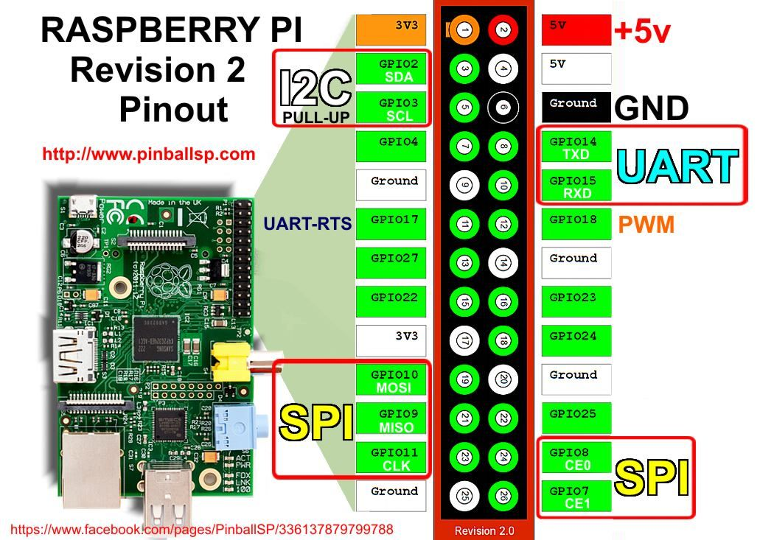
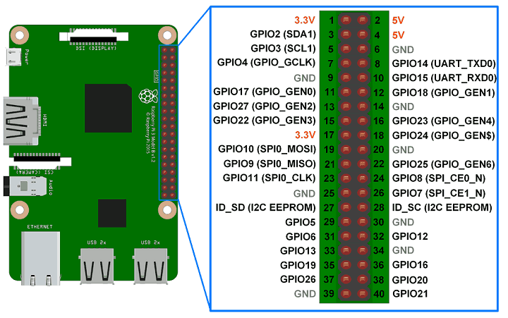
Pin out with MUX

Slide 8
Raspberry pi Models

Slide 9
Cont’d

Slide 10
Arduino & Raspberry pi

Slide 11
Raspberry pi Programming

Slide 12
Raspbian Operating System
Raspbian is the name given to a customized variant of the popular Debian Linux distribution.
Raspbian takes Debian as its base, or parent distribution, and adds custom tools and software to make using the Raspberry Pi as easy as possible.
To use Raspbian, you must enter a username and password.
The default username is pi, and the default password is raspberry;

Slide 13
Required Components
Raspberry pi
SD card We recommend an 8GB or higher
Display and connecting cables: Any HDMI/DVI monitor or TV should work as a display for the Pi
Keyboard and mouse:
Power supply:
Internet connection:

Slide 14
PLUGGING IN YOUR RASPBERRY PI
Begin by slotting your SD card into the SD card slot on the Raspberry Pi.
Next, plug in your USB keyboard and mouse into the USB slots on the Raspberry Pi. Make sure that your monitor or TV is turned on
Then connect your HDMI cable from your Raspberry Pi to your monitor or TV
If you intend to connect your Raspberry Pi to the internet, plug in an Ethernet cable into the Ethernet port next to the USB ports
Plug in the micro USB power supply. This action will turn on and boot your Raspberry Pi.
If this is the first time your Raspberry Pi SD card has been used, then you will have to select an operating system and configure it.

Slide 15
Python Programming Basics
COVERED

Slide 16
Introduction to Raspberry Pi Programming

Slide 17
GPIO in Python
the Python package used for Raspberry Pi GPIO programming is RPi.GPIO
It is already installed in Raspbian, the default operating system for Pi.
If you are using any other operating system, the package can be installed by using the following command:
$ sudo pip install RPi.GPIO
For the 3v3 pin (GPIO.PUD_DOWN), the input value of the open circuit will be 0 and of a closed circuit will be 1. For a ground pin (GPIO.PUD_UP), open circuit is 1 and closed circuit is 0.
GPIO.BOARD -- Board numbering scheme. The pin numbers follow the pin numbers on header P1.
GPIO.BCM -- Broadcom chip-specific pin numbers. These pin numbers follow the lower-level numbering system defined by the Raspberry Pi's Broadcom-chip brain.

Slide 18
The GPIO programming process
Step 1: Import the RPi.GPIO package.
Step 2: Set the numbering style to be used. We use the method GPIO.setmode() for this. It takes either GPIO.BOARD or GPIO.BCM as the parameter. GPIO.BOARD stands for physical numbering and GPIO.BCM stands for Broadcom numbering. In order to keep things simple, we will use only GPIO.BOARD here.
Step 3: Set up the necessary input and output pins.
Step 4: Read inputs and give outputs.
Step 5: Clean up GPIO and exit.

Slide 19
LAB1:
Blinking LED

Slide 20
import RPi.GPIO as GPIO #for the sleep method import time led = 8 #set numbering mode for the program GPIO.setmode(GPIO.BOARD) #setup led(pin 8) as output pin GPIO.setup(led, GPIO.OUT,initial=0) try: #turn on and off the led in intervals of 1 second while(True): #turn on, set as HIGH or 1 GPIO.output(led,GPIO.HIGH) print(“ON”) time.sleep(1) #turn off, set as LOW or 0 GPIO.output(led, GPIO.LOW) print(“OFF”) time.sleep(1) except KeyboardInterrupt: #cleanup GPIO settings before exiting GPIO.cleanup() print(“Exiting...”)

Slide 21
LAB 2: Push Button
Push button: connect one leg of the switch to any GPIO pin, say Pin 7, and connect the other to any 3.3V pin.

Slide 22
import RPi.GPIO as GPIO
import time
cnl = 7
GPIO.setmode(GPIO.BOARD)
# PIN 7 AND 3.3V
# normally 0 when connected 1
GPIO.setup(cnl, GPIO.IN, GPIO.PUD_DOWN)
try:
while(True):
print(GPIO.input(cnl))
time.sleep(1)
except KeyboardInterrupt: \\Ctrl+C keypress.
GPIO.cleanup()
print(“Exiting”)

Slide 23
Pulse width modulation for analogue output
Pulse width modulation is a means to generate analogue signals from digital signal sources.
PWM has two main characteristics – duty cycle and frequency.
The duty cycle is the amount of time a signal is in the high state in one cycle. It is expressed in terms of a per cent measure.
The frequency determines how fast the PWM completes a cycle. When the state of a digital signal toggles rapidly with changing duty cycle values, we feel that we get analogue signals.
two PWM pins in Raspberry Pi—PWM0 and PWM1

Slide 24
Functions
pwm = GPIO.PWM(channel, frequency)
pwm.start(dutycycle)
pwm.ChangeDutyCycle(dutycycle)
pwm.ChangeFrequency(frequency).
pwm.stop().

Slide 25
import time import RPi.GPIO as GPIO GPIO.setmode(GPIO.BOARD) led=8 GPIO.setup(led, GPIO.OUT) #starting with frequency 100 pwm = GPIO.PWM(led, 100) #stating with 0, that is off state pwm.start(0) try: while 1: #duty cycle from 0% to 100% for dc in range(0, 101, 5): pwm.ChangeDutyCycle(dc) time.sleep(0.1) #duty cycle from 100% to 0% for dc in range(100, -1, -5): pwm.ChangeDutyCycle(dc) time.sleep(0.1) except KeyboardInterrupt: pwm.stop() GPIO.cleanup()

Slide 26
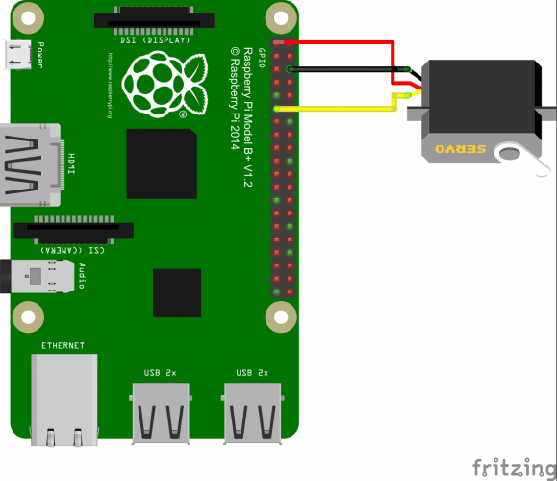
Servo motor
Black – comes to GND (pin 6) from the Pi Red – comes to 3V3 (pin 1) from the Pi Yellow/Orange – to a free GPIO pin (e.g., GPIO17, pin 11)
The amount of time the signal is on sets the angle the servo motor to rotate.
The expected frequency is 50Hz, or 3000 cycles per minute. Servos will set to 0 degrees if given a signal of .5 ms, 90 when given 1.5 ms, and 180 when given 2.5ms pulses. This translates to about 2.5-12.5% duty in a 50Hz PWM cycle.

Slide 27
Servo motor
import RPi.GPIO as GPIO
import time
servoPIN = 17
GPIO.setmode(GPIO.BCM)
GPIO.setup(servoPIN, GPIO.OUT)
p = GPIO.PWM(servoPIN, 50) # GPIO 17 for PWM with 50Hz
p.start(2.5) # Initialization
try:
while True:
p.ChangeDutyCycle(5)
time.sleep(0.5)
p.ChangeDutyCycle(7.5)
time.sleep(0.5)
p.ChangeDutyCycle(10)
time.sleep(0.5)
p.ChangeDutyCycle(12.5)
time.sleep(0.5)
p.ChangeDutyCycle(10)
time.sleep(0.5)
p.ChangeDutyCycle(7.5)
time.sleep(0.5)
p.ChangeDutyCycle(5)
time.sleep(0.5)
p.ChangeDutyCycle(2.5)
time.sleep(0.5)
except KeyboardInterrupt:
p.stop()
GPIO.cleanup()

Slide 28
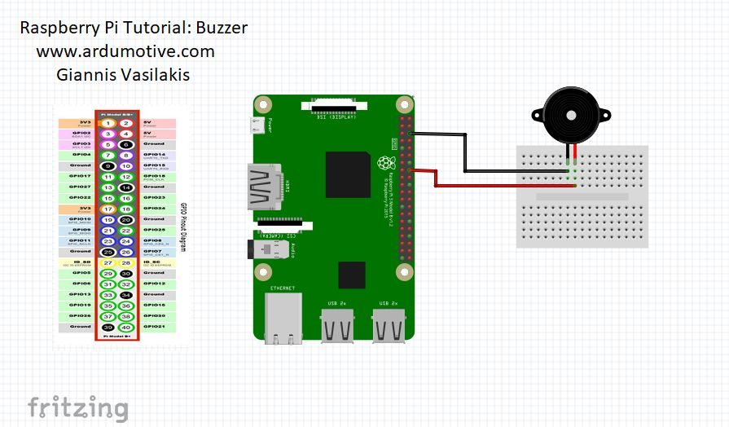
buzzer
import RPi.GPIO as GPIO
from time import sleep
#Select GPIO mode
GPIO.setmode(GPIO.BCM)
#Set buzzer - pin 23 as output
buzzer=23
GPIO.setup(buzzer,GPIO.OUT)
#Run forever loop
while True:
GPIO.output(buzzer,GPIO.HIGH)
print ("Beep")
sleep(0.5) # Delay in seconds
GPIO.output(buzzer,GPIO.LOW)
print ("No Beep")
sleep(0.5)

